Slide 1


Post-treatment control
Caroline T. Tiemessen
Centre for HIV and STIs,
National Institute for Communicable Diseases
DST/NRF Research Chair of HIV Vaccine Translational Research, University of the Witwatersrand

Slide 2
Background
Post-treatment controllers (PTCs): HIV-infected individuals who start ART (mainly during acute or primary infection), achieve very low or undetectable viral load and stop treatment (intentionally as part of structured treatment interruption studies/patient choice) – subsequent control off ART (transient or durable)
As with elite controllers (natural control of HIV to undetectable levels in the absence of ART), these cases provide hope that long-term remission may be possible in future
<1%
5-15%
HIV remission is uncommon, even with early treatment
Mechanisms underlying host ability to control HIV when ART is stopped?
HIV-infected

Slide 3
PTCs have been described:
Different geographical locations and ethnicities, different modes of transmission, different viral subtypes, different durations of ART, different timing of ART initiation
Adults and children, both genders
Saez-Cirion et al, PlosPath 2013; Stohr et al, Plos One 2013; Gianella et al, Antiv Ther 2011; Grijsen et al, Plos Med 2012 Lodi et al, Arch Int Med 2012; Maenza et al, Antiv Ther 2015); Li et al, AIDS 2016); Kinloch-de Loes et al, OFID 2015, Perkins et al JAIDS 2017, McMahon et al AIDS 2017, Maggiolo et al, AIDS 2018; Persaud et al, NEJM 2013; Frange et al, Lancet HIV 2015; Violari,Tiemessen et al, IAS 2017

Slide 4
Timing of ART initiation following HIV infection
Effects of early ART
Very early ART
Early ART
Chronic ART
Reduced immune activation
Limited virus escape/diversity
Reduced morbidity and mortality
Better control on ART
No seroconversion, lack of adaptive immune responses
Smaller reservoirs
Preserved immunity
Fiebig I/II (1-3 wks p.i.)
< 6 months
> 6 months - years
<48 hours of birth
Notes:
Fiebig I: HIV nucleic acid pos, p24 neg (viral capsid core protein), HIV antibody neg

Slide 5
Very early ART
The Mississippi baby
Adult cases

Slide 6
The “Mississippi baby”
From “cure” to relapse………
Very early ART - children
HIV RNA 19,812 c/ml
DNA+
Mississippi baby
ART at 30 hours
HIV RNA 16,750 c/ml
18 months
Viral rebound after 27 months off ART
1 month
No ART
No PMTCT
Premature
ART at birth: AZT, 3TC, NVP
Transient remission is possible
Is early treatment the key to preventing (or limiting) establishment of HIV reservoirs?
Notes:
No PMTCT, premature, triple drug treatment (AZT, 3TC, NVP) 30 hours after birth, VL undetectable by one month of age, lost track of mom and baby 12-15 months, lost-to follow up and received no treatment
Returned to care at 23 months – undetectable virus (now >3 years of age) – off treatment for 27 months
July 2014: VL rebounded to 16,000 RNA copies/ml, back on treatment

Slide 7
Cases of very early treated infants that stopped ART
30 hours
months
Birth
years
Viral rebound off ART
HIV RNA 19,812 c/ml
DNA+
Mississippi baby
ART at 30 hours
HIV RNA 16,750 c/ml
18mo
27 months
HIV RNA 653 c/ml
1 month
HIV RNA 11,230 c/ml
Dublin baby
ART at 30 mins
4yrs
49mo
8 days
1.3 months
HIV RNA 808 c/ml
HIV RNA 7,797 c/ml
Canadian baby
ART at <24 hours
3yrs
39mo
14 days
Detected cell-associated HIV RNA
6 months
HIV RNA 152,560 c/ml
HIV RNA 36,840 c/ml
Milan baby
ART at 12 hours
3yrs
36mo
High % activated T cells
HIV-specific T cell responses
14 days
3 months
All had undetectable: HIV DNA, HIV Ab
Persaud et al, NEJM 2013; Luzuriaga et al, NEJM 2015; Samson, Brophy, Bitnun et al, 2014; Giacomet, Lancet 2014; Butler et al, Ped Inf Dis 2015
Notes:
Cases with rebound : HIV DNA negative, replication competent virus negative, HIV antibody negative, undetected HIV-specific cells except Milan baby, cell-assoc RNA in Canadian baby and high % activated T cells in Milan baby

Slide 8
Inspired by the Mississippi baby:
Very early ART Clinical Trials in children
NIH: National Institutes of Health
IMPAACT [International Maternal Pediatric Adolescent AIDS Clinical Trials Group]
EIT [Early Infant HIV Treatment in Botswana]
LEOPARD [Latency and Early neOnatal Provision of Anti-Retroviral Drugs]
3 NIH-funded clinical trials:
  IMPAACT P1115 (9 countries) – Argentina, Brazil, Haiti, Malawi, South Africa, Uganda, US, Zambia and Zimbabwe
  EIT Botswana
  LEOPARD – Johannesburg, South Africa
Can early ART initiation soon after birth lead to remission of HIV such that children can stop treatment for an extended period of time?
What are the best biomarkers to monitor HIV persistence during ART that might predict remission?

Slide 9
Very early ART - adults
Case: Clark Hawley
8 Thai individuals
Henrich et al, Plos Med 2017
Colby et al, Nat Med 2018
54 yr old male
ART started approx. 10 days after infection
Plasma VL 220 cpm
34 months of continuous ART
VL rebound - 225 days after stopping ART Reinitiated ART
ART during Fiebig stage I (1-2 weeks)
Median duration of ART: 2.8 years
Rapid VL rebound – median 26 days (range 13-48 days)
All reinitiated ART
Relapse despite very early treatment initiation and fully suppressive ART
Small n. Is duration of remission affected by small differences in timing of starting ART?
CD30 and CD69 upregulation on CD4 and CD8 T cells prior to detectable VL
CD4:CD8 ratio ≤ 1 = faster time to VL rebound, also shown for early treatment Hurst et al, Nat Comm 2015
Notes:
Colby et al: 7 males, 1 female

Slide 10
Early ART
Durable remission > 7 years
VISCONTI cohort
“The French teenager”
“The South African child

Slide 11
The VISCONTI cohort
(Viro-Immunologic Sustained CONtrol after Treatment Interruption)
(n=14)
14 patients
ART in first
3 months
Control VL
after
stopping ART
>7 years
36 months on therapy
Why are these patients able to control HIV without ART?
Characteristics:
Sáez-Cirión et al, PLoS Pathogens 2013
Scott-Algara D. et al CROI 2015
More severe primary infections than HIV controllers
Small reservoir (HIV DNA) and in shorter-lived CD4 T cells
Low levels of T cell activation
Lack protective HLA-B alleles, poor CD8 T cell responses
Unique NK (Natural killer) phenotype, good NK cell responses
Notes:
Therapy started within 10 weeks following primary Infection
36 months on therapy followed by a median of 89 months (>7 years) of control off therapy
Incidence of viral control after interruption of early ART = higher among PTCs (5-10%) than for spontaneous control (<0.5%)
The mechanism of the viral control is different from that observed for HIV controllers
They don’t have protective genetic factors as found in natural HIV controllers
Poor CD8 T cell responses
More severe primary infections than HICs
Maintain low reservoir, and in some reduce this reservoir to very low
Low levels of T cell activation

Slide 12
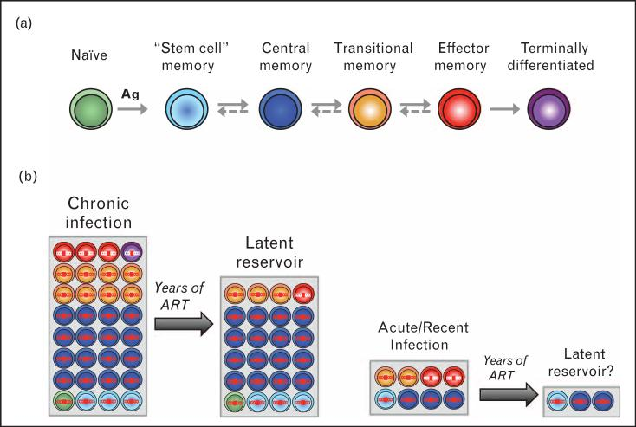
Size and composition of the latent HIV reservoir – timing of ART
Greater contribution of short-lived cells
Elite controllers
Post-treatment controllers
Ananworanich et al, Curr Opin HIV/AIDS 2015
Notes:
The size and composition of the latent HIV reservoir is affected by early ART. (a) Subsets of CD4 T cells can be identified based on the levels of expression of several cellular markers including CD45RA, CCR7, CD27 and CD95. The pathway of T cell differentiation, that is, the sequence of development of the different T-cell subsets, remains elusive in humans, and it is unclear if the differentiation pathway is linear or branched, one-way or reversible [31]. (b) In chronically infected patients, the contribution of TCM cells to the overall pool of infected cells is important [30]. As these cells are long lived, they survive after years of ART and represent the major latent HIV reservoir in patients who started ART during chronic infection [24■]. The contribution of T_{SCM} cells also increases with time [27■■]. Patients with acute or recent infection display a small size of the reservoir (as depicted by a reduced size of the grey box). In addition, their T_{CM} cells may be relatively preserved from infection, with a greater contribution of short-lived cells. After years of ART, this may result in a reservoir of a very small magnitude. ART, antiretroviral therapy.

Slide 13
“ The French teenager”
Zidovudine
Birth
6 yrs on ART
12 yrs off ART
VL undetectable: (<4 RNA copies/ml)
HIV DNA detectable
Can reactivate virus from cells (2 million CD4 cells)
CD4 count stable
Weak HIV-specific T cell responses
3mo
1 long-term remission (6.7%)
1 after 3 years (6.7%)
The French paediatric cohort (n=173)
ART start <6 months (n=100)
ART interruption (n=15), VL < 500 c/ml
ART duration: median 33 months
13/15 rebounded within 12 months (86.7%)
Dollfus et al, CID 2010
Frange et al, Lancet HIV 2015
Notes:
Zidovudine prophylaxis at birth, received ART for 6 years, discontinued for 12 years (VL undetectable, viral DNA detectable, can reactivate virus from cells)

Slide 14
“The South African child”
CHER trial: Treatment of HIV+ Infants
(2005-2011)
Deferred Therapy
(zidovudine + lamivudine + lopinavir/ritonavir
initiated when met WHO immunologic or clinical criteria)
(n = 125)
Treatment-naive,
HIV+ infants
aged ≤ 12 weeks with
CD4% ≥ 25%
(N = 411)
Early Therapy for 40 weeks
(zidovudine + lamivudine + lopinavir/ritonavir
initiated immediately, continued to 1 year of age)
(n =143)
*
Early Therapy for 96 weeks
(zidovudine + lamivudine + lopinavir/ritonavir
initiated immediately, continued to 2 years of age)
(n = 143)
ART was re-initiated if CD4% <20 % and clinical criteria were met
CHER: Children with HIV Early Antiretroviral Therapy
Violari et al, NEJM 2008

Slide 15
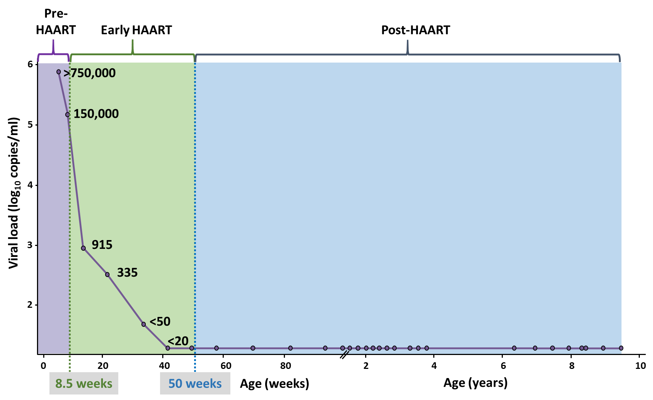
Prolonged HIV-1 control post-ART
AZT/3TC/Lopinavir-ritonavir – 40 wks
HIV antibody negative
DNA PCR negative
Viral load TND
CD4 counts normal-for-age
VL undetectable: 8.75 years off ART
?
9.5 years
DNA PCR positive at 32 days of life
Notes:
DNA PCR positive at 32 days of life
Initiated AZT/3TC/Lopinavir-ritonavir at 8.5 weeks of life
Interrupted ART after 40 weeks (age 1 year), as per trial randomisation
3-monthly clinical and CD4 evaluations in CHER until age 4 years
3-monthly follow up as part of PEPFAR and the NICHD-funded CHANGES study to date
Undetectable viral load with standard assays after 8.75 years off ART on stored and current specimens
Time to suppression: < <400 at 20wks (20 – 8.5 = 11.5 wks min)= <3mo

Slide 16
How unusual is this child?
Time to VL rebound – the CHER trial
ART start 6-12 weeks*
Remission
Rebound
The South African child
> 9 years remission
One/178 (0.6%)
One/227 (0.4%)
177/178 rebounded within 8 months (99.4%)
ART stopped; virally suppressed
226/227 rebounded (99.6%)
Longer time to rebound independently associated with: higher baseline CD4%, higher birth weight, faster viral suppression
ART stopped
No association with: Age at ART initiation*, duration of therapy
Violari, Tiemessen et al, IAS 2017
Violari et al, NEJM 2008; Cotton et al, Lancet 2013
Violari et al, CROI 2018

Slide 17
Summary of key findings
Viral features
VL 6.6 copies/ml (tested in 10 ml: 66 copies)
HIV DNA detectable (5 copies/million PBMC)
No replication-competent virus (2 million CD4 cells)
Subtype C
Host features
CD4 count stable, high CD4%, high CD4:CD8 1.9
Low immune activation (< uninfected controls)
Low CCR5 (surface density) (< uninfected controls)
High PD-1?
A weak Gag-specific CD4 T cell response, no detectable HIV-specific CD8 T cell responses
Mostly weak HIV-specific antibodies; high magnitude IgA2 response (mucosal) to gp41
Host genetic features – potentially disadvantageous for acquisition of infection (HLA DQB1*06; KIRAA1), others potentially advantageous (heterozygosity) for control of infection (HLA class II?)
HIV-specific T cell responses
Y
Y
Y
HIV-specific antibodies
Y

Slide 18
The need for predictive biomarkers
Biomarkers for longer time to viral load rebound after treatment interruption:
Clinical parameters:
Early ART, longer duration ART, high CD4 nadir, CD4:CD8≥1, CD4%....
Low markers of HIV reservoir size:
Active reservoirs, CA-RNA, single copy HIV RNA
Cell-associated total HIV DNA
Li et al, AIDS 2016
Williams et al, eLife; Saez-Cirion et al, Plos pathogens 2013
Strong HIV-specific immune responses:
HIV-specific CD4+ T cell responses
Low expression of PD-1, Lag-3 and Tim-3 on CD4 and CD8 T cells
Unique NK cell phenotype and function
Frater et al, AIDS 2014
Hurst et al, Nat Comm 2015
Scott-Algara, CROI 2015
A complex interplay between virus reservoir and host immunity
Treatment interruptions: test-of-cure or to test for post-treatment control – a necessary evil

Slide 19

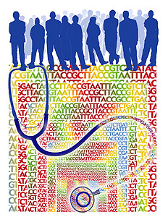
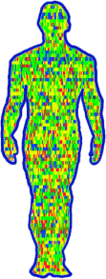

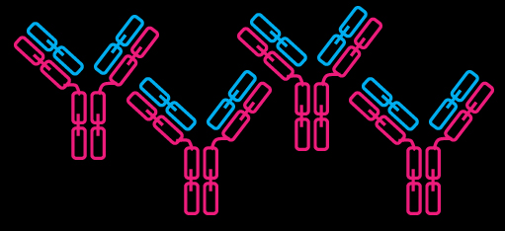

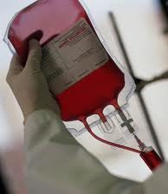

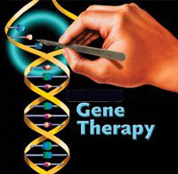
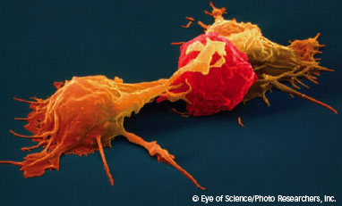
What will it take to achieve HIV remission?
Early treatment = desirable, but not enough for the majority
Post-treatment controllers tell us that other factors, unique to an individual or to very rare groups of individuals, are important
understanding
THE VIRUS
THE HOST
informing
HAART
+
The clues are there, we need to find these from the few and turn them into solutions for the many

Slide 20

Acknowledgements
NICD/Cell Biology
Perinatal HIV Research Unit
Sharon Shalekoff
Diana Schramm
Maria Paximadis
Ria Lassauniere
Shayne Loubser
Bianca da Costa Dias
Ntando Phaahla, Sizanani Mncube, Gemma Koor
Avy Violari
Kennedy Otwombe
Afaaf Liberty
Columbia University, NY, USA
Louise Kuhn
Stellenbosch University
Medical Research Council, Clinical Trials Unit,
University College London, United Kingdom
Mark Cotton
Anova Health Institute
Diana Gibb
Abdel Babiker
James McIntyre
Rahima Moosa Mother and Child Hospital (Wits)
Ahmad Haeri Mazanderani
Renate Strehlau
HIV functional cure/Elite controller study:
Neil Martinson (PHRU)
Osman Ebrahim (Brenthurst Clinic)
Dave Spencer (Right-to-Care)
Prudence Ive (Helen Joseph Hospital)
Photini Kiepiela (MRC)
Maria Papathanasopoulos (Wits)
Michele Ramsay (SBIMB, Wits)
Marion Vermeulen (SANBS)
Funding:
Thanks to patients and healthy volunteers; nursing and other support staff

